Slide 1
Natural Language Processing with Disaster Tweets
Kaggle competition
Team P40: Jüri Jõul, Sten Salumets, Tarvi Tepandi
Notes:
Tarvi
We are…
Project is the Kaggle competition titled…

Slide 2
At least one member from the team (can be more than one) makes a presentation about the project. Others should attend as well, to support and help with QA.
As intermediate presentations, the final presentation will also be held solely online with two practice session leaders grading the presentations over Zoom.
You have 5 minutes to make the final presentation
in the presentation make sure to introduce your team and project owner (if applicable);
briefly remind us the problem you are trying to solve (say why it needs to be solved);
explain what was your approach to the problem (your methods);
detail results you have obtained and how they match the initial expectations;
Lastly, describe a few main lessons that you have learned while working on the project.

Slide 3

Problem statement
“Given a tweet, predict whether
this tweet is about a real disaster.”
Notes:
Tarvi
Our main problem can be summed up in one sentence: “Given a tweet, predict whether
this tweet is about a real disaster.”

Slide 4
Importance
1
2
Fake News
Disaster Relief
Helping to avoid the propagation of fake news by detecting them early.
Help disaster relief organizations in finding the people who need their help.
Notes:
Tarvi
Solving this problem is very important in today’s world, because a lot of communication takes place on social media. Both news agencies and authorities often use social media to find important information.
Since there is a lot of information, we need computers to do this job for us. This will not only help make the information collected by news agencies more reliable and therefore prevent the spread of fake news, but it will also help disaster relief organizations in finding the people who need their help.

Slide 5
Project description
Familiarize ourselves with natural language processing (NLP) techniques
Process dataset
Choose the best performing algorithm
Predict
Notes:
Mina kustutaks selle slaidi ära..

Slide 6
Process
Preprocess the data
Fancier machine learning model (CNN)
1
2
3
4
Simple machine learning models
The fanciest machine learning model (BERT)
Notes:
Sten
Our work progress can be split into four separate parts.
First we preprocessed the data, making it possible to train models on it. Then, we tested familiar simple machine learning models. From there we moved onto fancier machine learning models: CNN and BERT.

Slide 7
Dataset
 | Keyword | Location | Text | Target
Example 1 | apocalypse | Albuquerque | And so it begins.. day one of the snow apocalypse | 1
Example 2 | airplane accident | y(our) boyfriends legs | I almost sent my coworker nudes on accident thank god for airplane mode | 0
Example 3 | bush fires | somewhere outside | Bush Fires are scary....even scarier when you go down and fight them | 1
Example 4 | danger | Uruguay / Westeros / Gallifrey | I am not in danger Skyler. I AM THE DANGER. | 0
Notes:
Sten
A quick reminder about the dataset. It consists of 10 000 Tweets that have been manually given the label of ‘disaster’ or not. The dataset has three features: ‘keyword’, ‘location’, and ‘text’. Since ‘keyword’ and ‘location’ didn’t prove to be reliable features (there were lots of gag entries) then these features were disregarded by us.

Slide 8
Dataset preprocessing
Remove stop words and lemmatize
Encode words into numbers
Keras Tokenizer()
Smaller number == more frequent word
Our vocabulary is 28848 words
Original: Our Deeds are the Reason of this #earthquake May ALLAH Forgive us all
Without stop words and lemmatized: Our Deeds Reason #earthquake May ALLAH Forgive u
Encoded: [697, 5738, 590, 216, 108, 1760, 3716, 20]
Notes:
Sten
For preprocessing we started with the removal of stop words and lemmatizing. A stop word is a commonly used word that gives no new information to the sentence and can thus be removed. Lemmatization is the process of linking words with similar meanings to one word, thus reducing the amount of words in the vocabulary.
The resulting text was then encoded into numbers by using Keras Tokenizer. This looks through the whole data and encodes each unique word to a number. The smaller the number, the more frequent the word. This enables to filter out infrequent words if need be. Our dataset vocabulary ended up consisting of 28848 words.
Below can be seen the example of the progress of preprocessing the data.

Slide 9
Predictions
Split work into three:
Trivial machine learning models
CNN
BERT

Slide 10
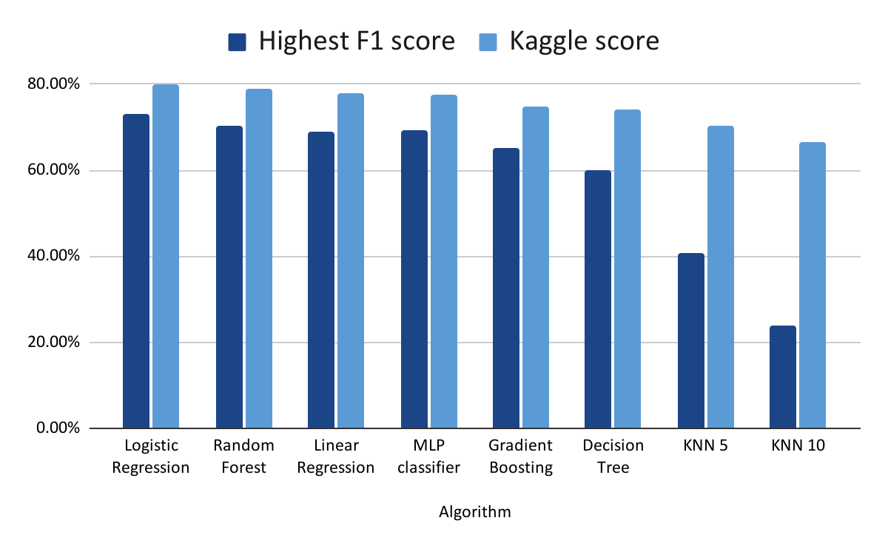
Predictions with trivial models
A variety of simple classification algorithms
Vectorized tweet text vocabulary as columns
Default model parameters for most cases
Algorithm | Highest f1 score | Kaggle score
KNN 5 | 40.63% | 70.242%
KNN 10 | 23.83% | 66.411%
Linear Regression | 69.10% | 78.026%
Logistic Regression | 72.99% | 79.987%
Random Forest | 70.44% | 78.792%
Decision Tree | 59.96% | 74.195%
Gradient Boosting | 65.28% | 74.747%
MLP Classifier | 69.28% | 77.627%
Notes:
Tarvi - 30sek
A variety of relatively simple classification algorithms were tried. For them, the vocabulary of tweet texts was vectorized, each vector a column. Each row or tweet then had either a 0 or 1 if the word was present.
The scoring was inconsistent from algorithm to algorithm. The worst achieved result was from the 10-nearest-neighbour algorithm. However, the best was achieved with the Logistic Regression algorithm. I find it interesting that kaggle scores for all algorithm bar one were between 70 and 80%.

Slide 11
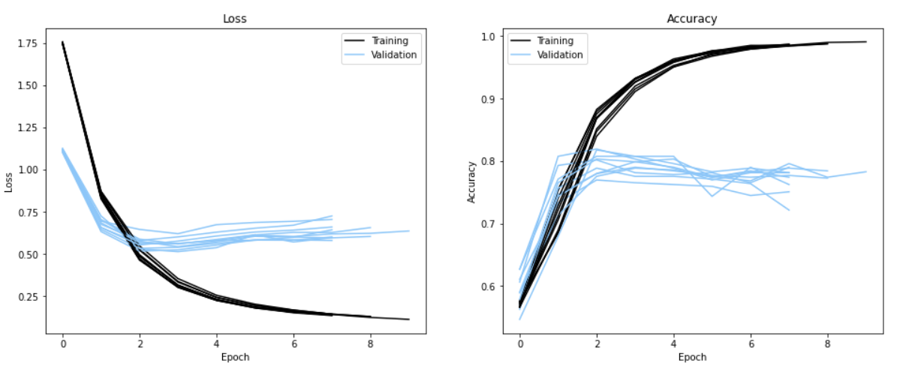
Predictions with CNN
Embedding layer
Convolutional and max-pooling layer
Flatten matrices into vectors
Dense layers
20 epoch training
Early stopping and model checkpoint
Cross-validation
Kaggle score 79.190%
Notes:
Next up, conventional neural network model’s applicability to the dataset was tested.
The tried network consisted of the following layers in the following order: embedding, convolutional, max-pooling, flatten, and two dense layers.
The model was trained on 20 epochs, but with early stopping enabled and current best model held in memory. CNN was trained by 10-fold cross-validation.
CNN managed the best Kaggle score of 79.1%. As can be seen in the figures, the model suffered from overfitting. We didn’t see much improvement fighting it, so we decided that there was simply not enough data to train a conventional neural network.

Slide 12
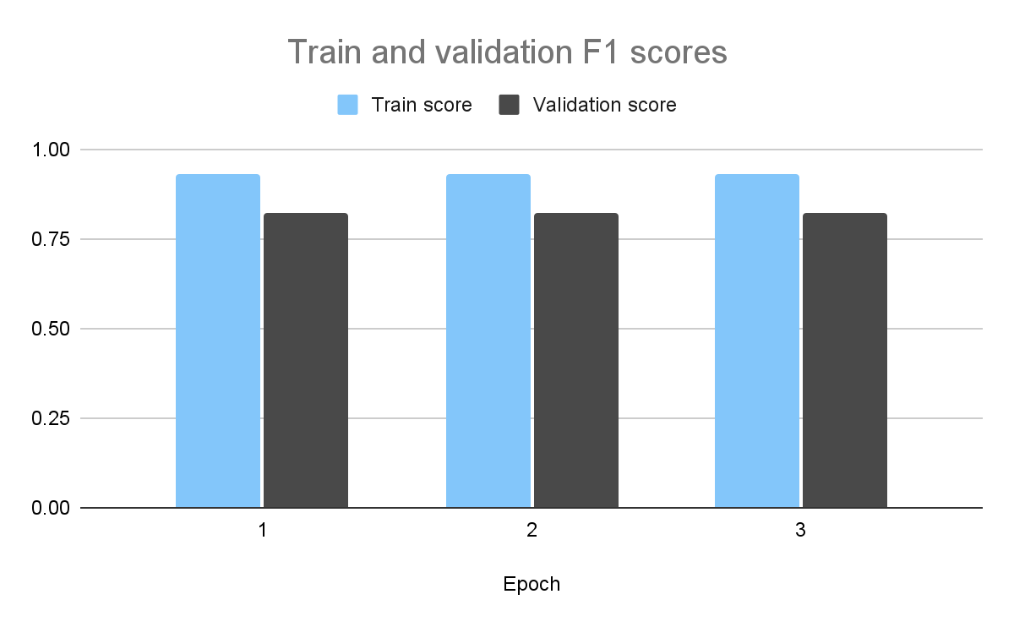
Predictions with BERT
DistilBERT model
Less parameters, faster
Base model + fine tuning
Model | Validation F1 | Kaggle F1
DistilBERT | 84% | 83%
DistilBERT with preprocessing | 82% | 82%
Notes:
Jüri
Finally, we tried the state-of-the-art natural language processing transformer-based model BERT. BERT models have shown good performance in many natural language processing tasks and therefore we decided to also try it out on our task. This was a great idea, as the results achieved with BERT were better than those achieved with both the simpler models and the CNN.
It is also important to mention that the single best legitimate result in Kaggle was a score of 89% and the other best models following that one were around 85%. So all in all, we did not achieve the best result but definitely not the worst either.

Slide 13

Problems and blockers
Difficult topic
Bad data
Lot of time spent reading about NLP
Label not correct in many cases
Public test dataset
Computation
People publish perfect scores
Computationally expensive
Notes:
I would also like to mention some of the problems we experienced. First, natural language processing is quite a difficult topic and we had to spend a lot of time studying it. Secondly, the competition’s test dataset is public and so it is difficult to determine which scores on Kaggle are real and which are not. Thirdly, the data contains many bad samples, where the label is obviously incorrect. Finally, training the more sophisticated models is computationally quite time-consuming.

Slide 14
Results vs. expectations
We did not expect some of the trivial models to perform so well
Similarly, we hoped for the more sophisticated models to perform better
Notes:
As to our results, we were pretty surprised that even the trivial models performed quite well on such a complex task. On the other hand, we were expecting a bit more from the sophisticated models.

Slide 15
Lessons learned
Hands-on experience with NLP
NLP techniques and state-of-the-art
Notes:
And finally, although we learned many lessons during the project, the most important ones are that we got some real hands-on experience with natural language processing and learned about the different techniques most widely used today.

Slide 16
Thank you for listening!

Slide 17
How we are going to do it
Initially we’ll try out simple algorithms
Not to work on the text but features of the text
Natural Language Processing (NLP)
Recurrent Neural Networks (RNN)
Long Short-Term Memory (LSTM)
Bidirectional Encoder Representations from Transformers (BERT)
Ideas from Kaggle Discussion page
Others’ thoughts about RNN, LSTM, BERT (84%)
Global Vectors for Word Representation (GloVe) embeddings and LSTM (79%)
Naive Bayes vs Ridge Regression, cross-validation (78%)
Feature extraction examples
Notes:
Tarvi
Okei, r22gin juurde, et maybe LR,RF, elasticnet
Peamine siiski tekstit88tlus aga mby for cross-validation

Slide 18
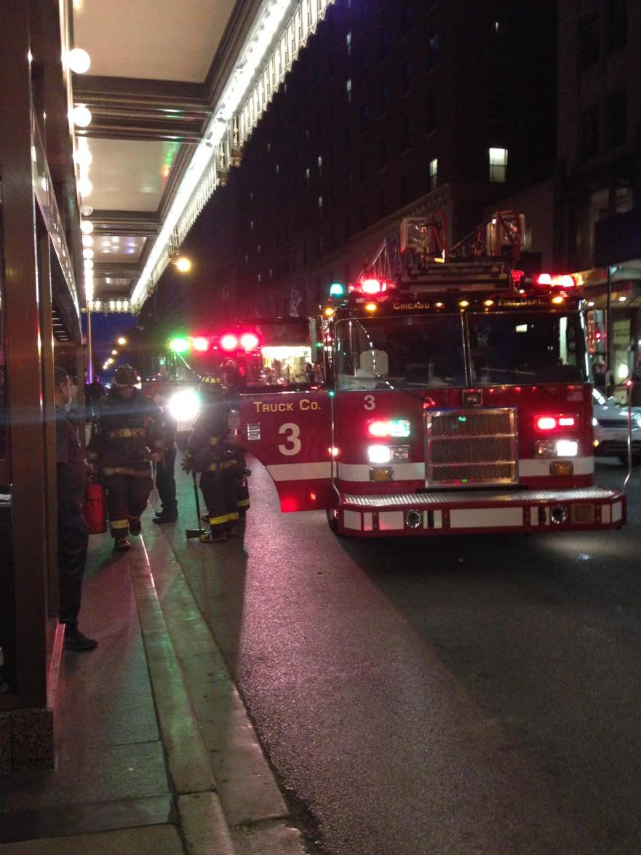
Blockers/problems
Can practice NLP, but the methods achieved will most likely not be useful
Test dataset is public, difficult to compare performance
 | Keyword | Location | Text | Target
Example 1 | crashed |  | My iPod crashed..... #WeLoveYouLouis #MTVHottest One Direction | 1
Example 2 | crush | Everywhere | sevenfigz has a crush: http://t.co/20B3PnQxMD | 1
Example 3 | ablaze |  | I wanted to set Chicago ablaze with my preaching... But not my hotel! http://t.co/o9qknbfOFX | 0
Notes:
Sten
Next about our blockers and problems. First, it seems that we can indeed practice natural language processing, but the methods achieved will most likely not be useful, because we have discovered that the dataset has elements that are not correctly labeled, at least to our understanding. On the slides there are some examples, like for example the dataset has classified a crashed iPod as a disaster, which to our right mind, isn’t true
Our second problem is that since the test dataset’s labels are public, then Kaggle has numerous high-scoring submissions, even with scores of 1. This makes comparing our performance to others difficult.

Slide 19
What we want to achieve
Reliable prediction
Understanding NLP
Notes:
Tarvi
As is probably obvious from the problem statement, we want to achieve reliable prediction of whether a tweet is about a disaster or not. We only have this soft goal because right now, it is too difficult for us to estimate what our score should be in the competition in order for us to be satisfied with our work.
A secondary goal is to better understand how natural language processing works, since we have not covered this field in the lectures.

